Slide 1
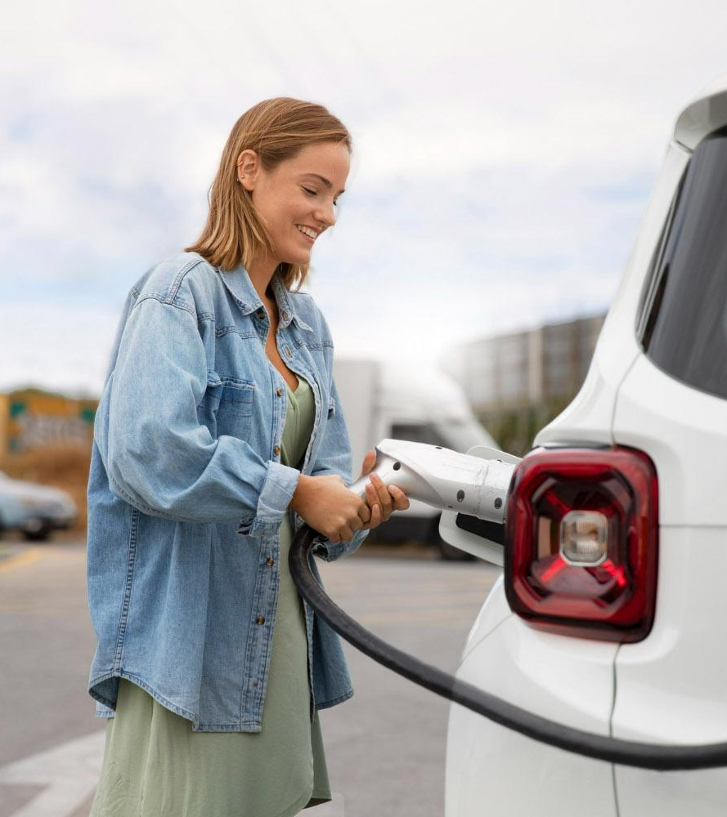
Optimizing Electric Vehicle Routing for Sustainable and Efficient Transportation
Aman Agrawal 2001CS04
Under the guidance of : Dr. Arijit Mondal

Slide 2
Why?
$100,00,00/yr
A single company has the potential to achieve substantial savings, making this problem particularly intriguing to tackle.

Slide 3
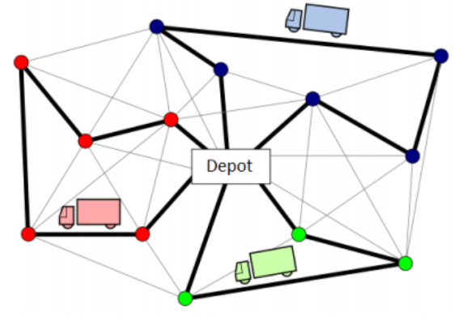
Problem
Given a fleet of EVs with limited battery charge levels and limited cargo load capacity, we need to find the best possible route for each EV, starting and ending at the central depot, satisfying customers' delivery demands.

Slide 4
The objective function of the E-CVRP is to find a set of EV routes that minimize the total distance traveled where:
Every customer is visited once and only once by exactly one EV.
All EVs start and end at the depot.
All EVs always start fully charged from the depot, e.g. y₀ = Q.
All EVs always start with fully loaded cargo from the depot, e.g., u₀ = C.
For every EV route, the total delivery demand of customers does not exceed the EV’s maximal cargo load C(for symmetric vehicles) and for C_{t}(∀ t ⊂ K(set of vehicles) for all asymmetric vehicles).
The battery charge level on each traveled arc is never negative.
EVs always leave a charging station fully charged. (Most imp: Not considering partial charging for now.)
The charging stations can be visited multiple times by any EV.

Slide 5
Now, the discharging rate could be estimated and incorporated in two ways:
(Discrete values)The vehicle’s discharging rate at the moment, i.e., for the arc(i,j), the discharging rate would be proportional to the vehicle's load, and after it drops off the package at location j, the rate would get reduced.
(Continuous values)The time over which it’s being driven.
Why?
Since optimizing for the distance parameters for now, with some ideal parameters, this can be converted to include this constraint when:
a. No re-routing happens, i.e., following precisely the same path the algorithm gave.
b. The speed of the vehicle remains constant.
c. The charging time and all other miscellaneous times remain nil.
For the future scope, after including time parameters: A. Partial charging
B. Charging time for the vehicles(Linear/Non-Linear)
C. The maximum allowed number of charging vehicles at a particular station thus might divert to another station not optimal according to the distance constraint.
D. Battery swapping)

Slide 6
Starting off with the basics:
CVRP: Capacitated Vehicle Routing Problem
This version solves:
Minimum number of vehicles required with a specific weight to satisfy all the customers with their required cost and minimizing the total distance travelled.
Why: Since solving with all the vehicles the depot has can prove quite worse in some scenarios, for example, including all the vehicles for a day with the minimal number of deliveries to be completed, suppose on a holiday or national lockdown, is highly inefficient.
With this, we would find an optimal number of vehicles and then proceed for actual.

Slide 7
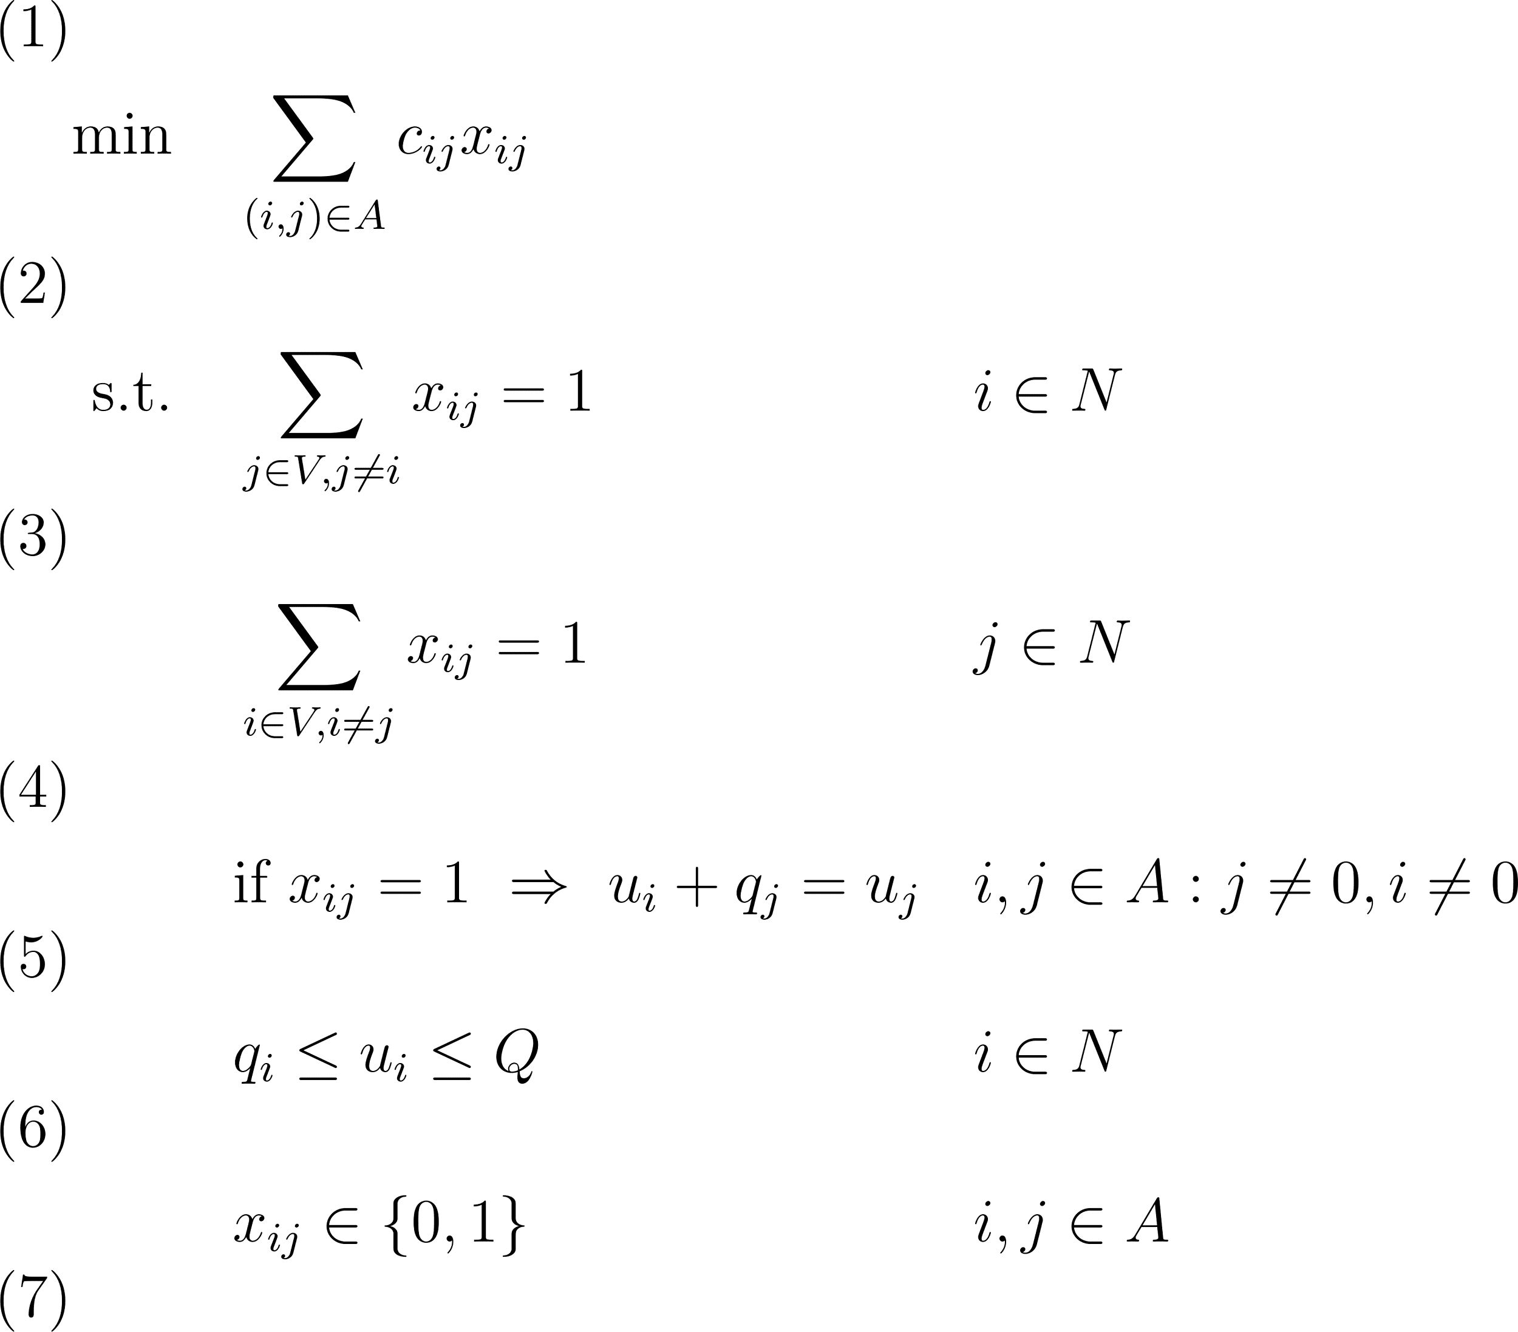
MILP Formulation: CVRP
• n is the number of clients and N = {1, . . . , n}: denotes the set of clients.
• V = {0} ∪ N: Set of nodes, where 0 represents the Depot.
• A = {(i, j) ∈ V 2 : i ̸= j}: Set of all arcs in the network.
• ci,j: Cost of transportation from node i to node j, where (i, j) ∈ A.
• qi: Amount that has to be delivered to the customer at i ∈ N.
• Q: Vehicle Capacity

Slide 8
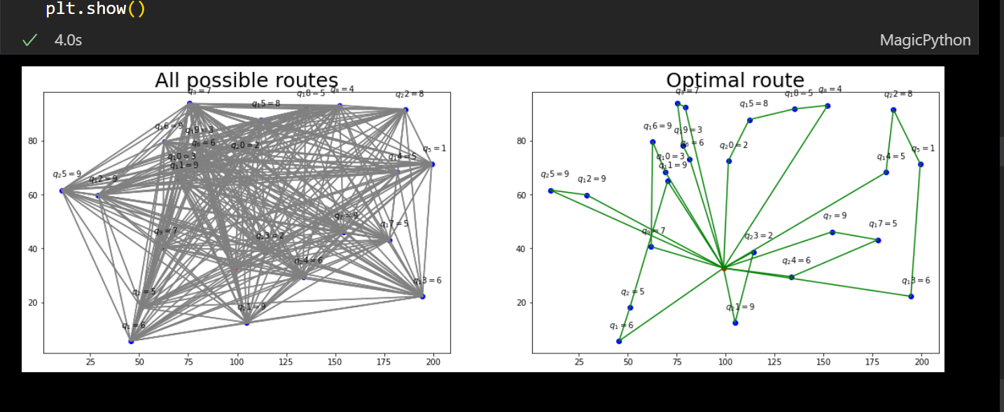
Results

Slide 9
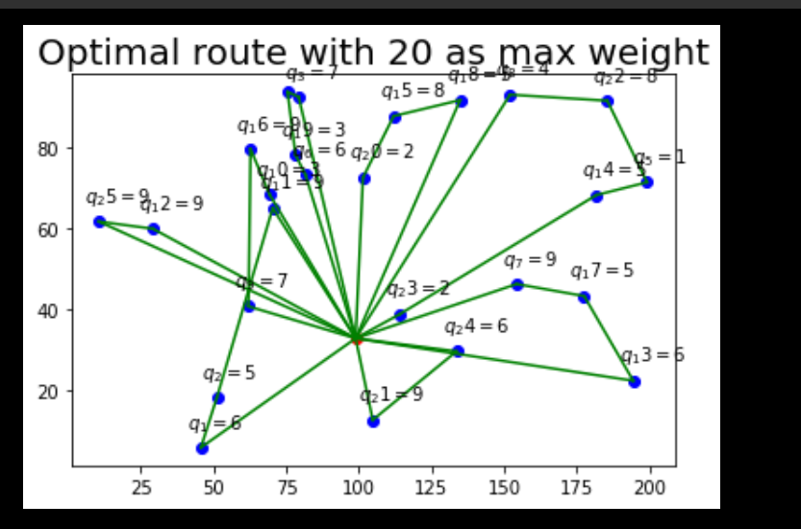
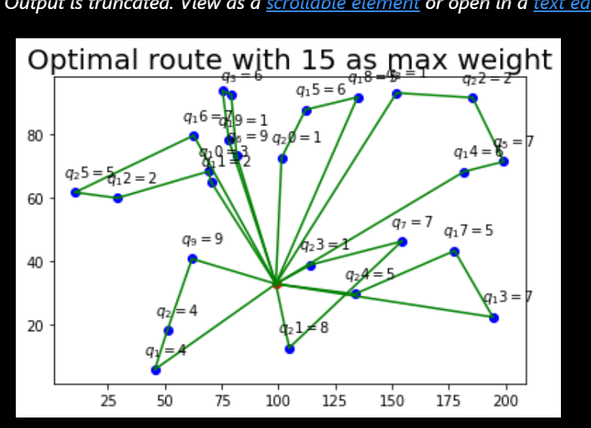
Results

Slide 10
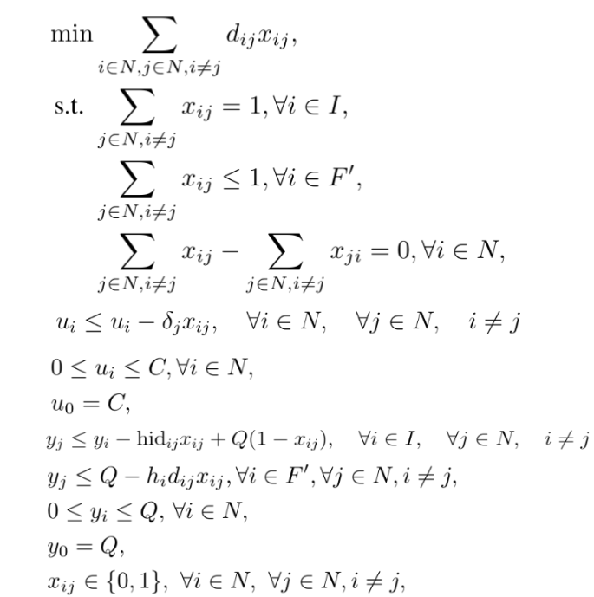
MILP Formulation: E-CVRP
y_{i} is the charging available after visiting the customer i
h_{i} : discharging rate for the arc (from any j) to i
u_{i} is the vehicle weight after delivering customer i
Q: Max charging capability
I, set of customer locations
N = {0} ∪ I ∪ F′
d_{i,j} (>0)is associated with each arc representing the Euclidean distance between nodes i and j.
Node 0 denotes the central depot.
I ⊂ N denotes the set of customers, where each customer i ∈ I is assigned a
positive value δi indicates the customer’s delivery demand that is to be fulfilled by the vehicle.
F’ ⊂ N denotes the set of charging stations(with multiple copies).
For now, including two copies for each node(since we can visit charging stations before going to customer i and after going to customer i), so F’= 2*|I||F|
Sample h_{i} : ( K+u_{i} )/C
K: Constant

Slide 11
Future Work
Implementing it by incorporating the number of vehicles and other constraints would be part of the future work.
Forming more formulations and then testing on real data and then using metaheuristic algorithms to evaluate for large constraints for real world applications.
Developing an Android application that provides drivers with integrated features for navigation, contact information, charging scheduling, and route guidance, alongside a web platform for entering location details and other relevant information, while ensuring seamless communication with the drivers for task execution.

Slide 12
Thankyou

